Slide 1
Practice 2
Simple examples
Common errors

Slide 2
Sample Program
/* *****************************************
This is a Simple Java Program.
This Programs Prints “Hello University, First Stage”.
************************************************** */
class Firstlec
{
public static void main(String Args[])
{
System.out.println("Hello university, First Stage");
}
}

Slide 3
Sample example 3
Write A program To print Your (Name, Age) using one statement.
Example:
My name is Sahnia Ali,
and I’m 20 Years Old.

Slide 4
Solution
class Myname{
public static void main(String [] args) {
System.out.println(" My name is Sahnia Ali\n and I’m 20 Years Old.");
}
}

Slide 5
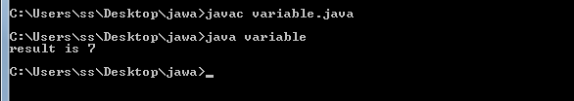
Variable (Integer)
public class Variable
{
public static void main(String[]args)
{
int a=3;
int b=4;
int c;
c=a+b;
System.out.println("result is "+c);
}
}

Slide 6
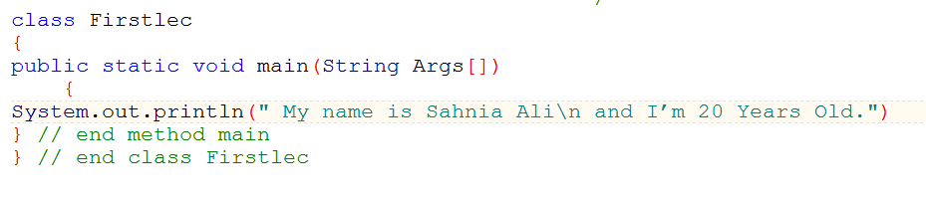
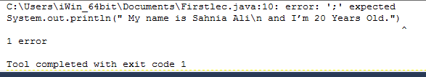
Common errors
Missed semicolon(;) here
Forget semicolon (;)

Slide 7
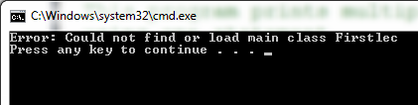
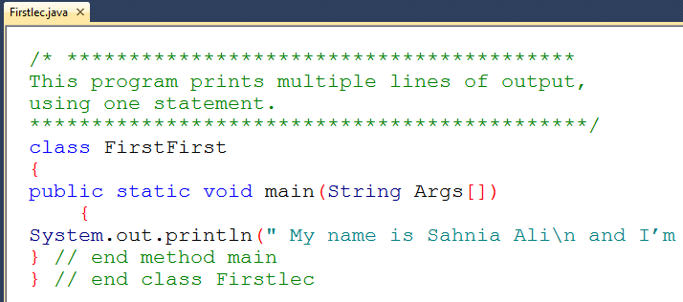
Common errors 2
class name and file name should have the same name;

Slide 8
Exercise
Make some Error and explain what happen?
Omit the following one by one And explain what happen :
public
static
String
class

Slide 9
References
http://www.programmingsimplified.com/java-source-codes
http://www.tutorialspoint.com/javaexamples/
Introduction to Java Programming Brief Version 10th ed. Y. Liang

Slide 10
Thank you

